Slide 1
Computer Languages
Computer Software Part 1

Slide 2
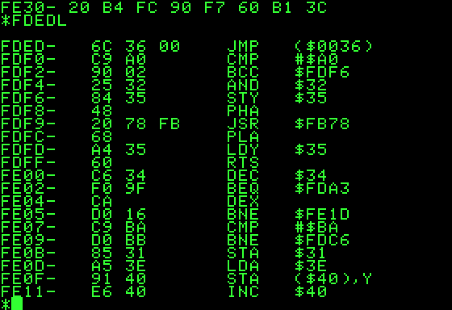
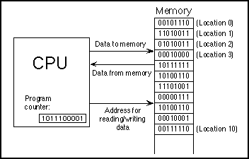
Machine Code
Written in binary code
1 to 3 Bytes in length
Displayed in Hexadecimal (4 bits ➔ 0 to 15 ➔ 0 to F)
A set of instructions executed directly by the computer processor
Each instruction performs a very specific and limited task

Slide 3
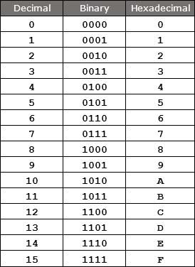
Hexadecimal
Base 16 number representation
Used to represent 1 byte of computer memory (4 bits)
Binary: 0000 up to 1111
Decimal: 0 to 15
Hex: 0 to F
Values of “10”, “11”, etc. are represented by letters “A”, “B” etc.

Slide 4
Assembly Code
A very low level programming language
Written in plane text
Almost one-to-one relationship between assembly code and machine code
Portability:
The same Assembly Code may be used to produce different machine code for different processor types.
Machine Code
Assembly Code
Memory Location

Slide 5
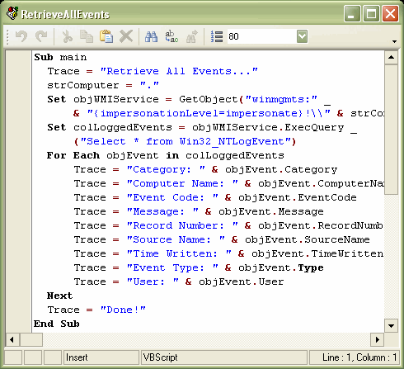
Procedure Based Languages
Examples: Fortran, C, Basic
Introduced in the 1970’s
The basis of all High Level Languages
Highly Portable: Same program can be compiled for different brands of computers
Much easier to program than Assembly Code
One High-level statement results in many Assembly Code instructions.
Almost as efficient as Assembly Code
specifies a series of well-structured steps and procedures to complete a computational task
Data and logic steps are defined separately

Slide 6
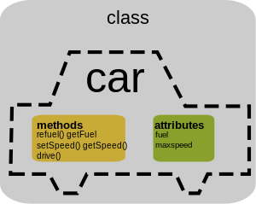
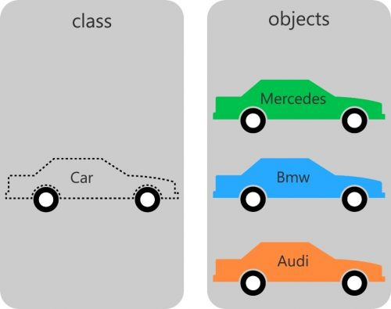
Object Oriented Languages
Examples: Java, C++, Python
Introduced in the 1990’s
The Evolution of High Level Languages
Although Slower and Less efficient than Procedural languages or Assembly code
Makes large programs easier to design and create.
Encourages re-use of code
Organized around objects rather than "actions" logic steps.
objects contain both data and logic together.
Have properties (data) and methods (actions).
Code inside an object makes use of procedural language structures and logic.
Your program can
“import” code written
By other programmers And then extend the base code to create more specific objects

Slide 7
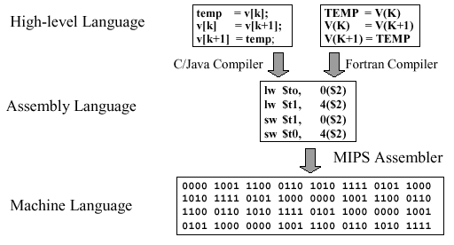
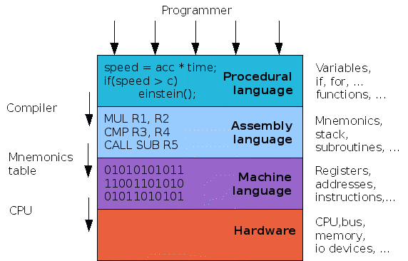
Summary

